Slide 1

UK Giving Report 2026 Charitable Giving Insights | CAF

Slide 2
CAF Charity Services – Our family of entities
Supporting you with your finances, the CAF Group offers a range of financial services to help your charity have a bigger impact. This summary is aimed at providing an overview of these entities, their regulators, remits and products.
Charities aid foundation
(caf)
CAF Bank
CAF financial solutions limited
(cfsl)
Parent organisation
Aims: To accelerate progress in society towards a fair and sustainable future for all
Regulated by the Charities Commission 268369 and HMRC
Common products:
  CAF Donate – our electronic giving portal
  Venturesome Impact Fund –offering non-regulated unsecured lending and blended finance packages (part loan/part grant)
  CAF Grant Making
  CAF Advisory
  CAF Give As You Earn
  Philanthropy products
  CAF America – ‘Friends Fund’ - a cost-effective way to receive support from US donors
Wholly owned subsidiary of the Charities Aid Foundation
Aims: Banking with a Purpose to support the third sector
CAF Bank Limited is authorised by the Prudential Regulation Authority and regulated by the Financial Conduct Authority and the Prudential Regulation Authority under registration number 204451
Common products:
  CAF Cash – our everyday current account
  CAF Gold – our savings account
  CAF Bank Loans – our non-regulated lending products
  Business Debit Card
Wholly owned subsidiary of the Charities Aid Foundation
Aims: Provides charitable investors with access to both savings accounts and longer-term investment options
CAF Financial Solutions Limited (CFSL) is authorised and regulated by the Financial Conduct Authority under registration number 189450
Introductions to a range of services provided by partners including:
  CAF Charity Deposit Platform
  Investments – ESG Fund Range
CAF Bank loans are non-regulated products. Loan applications subject to credit assessment. Security will be required. Charity assets may be at risk if you do not keep up with the repayments for a mortgage, loan or any other debt secured on them. If you're thinking of consolidating existing borrowing, you should be aware that you may be extending the term of the debt and increasing the total amount you pay. The value of investments may fall as well as rise. You may not get back the full amount that you originally invested. Past performance is not a guide to future performance. There is no guarantee about the level of capital or income returns that will be generated.
Notes:
Content:
This is where the majority of slides in a presentation should exist. Choose the layout that suits the information you’d like to show. For this slide, type into the sub-title section to add a sub-title which could be the topic (divider) of this section of the power point. If not required, delete the text box. Add a title in the title section.
There are 4 areas where you can add an image. Please select the icon to add a picture and upload an image from one of our charity photoshoots. These images can be found on the intranet. Underneath each image is a content box where you can add copy in a bullet point format or paragraph that correlates to the image above.
Do not change the colours, fonts, bars, layout or weighting of this slide.

Slide 3
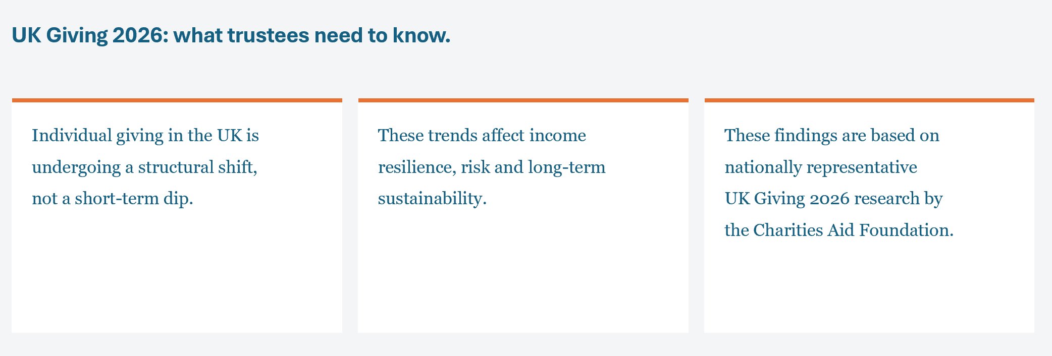



Slide 4
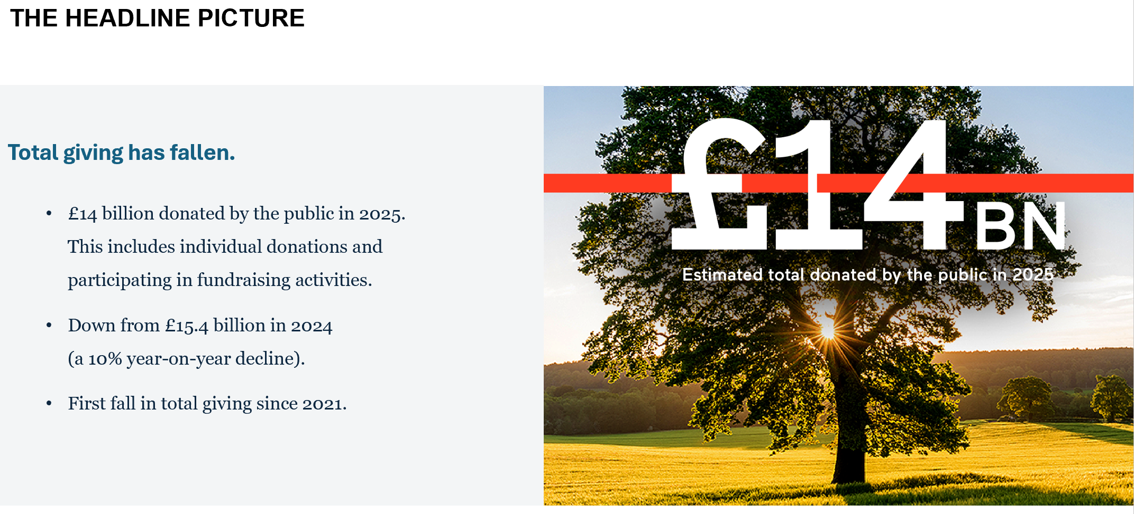

Slide 5
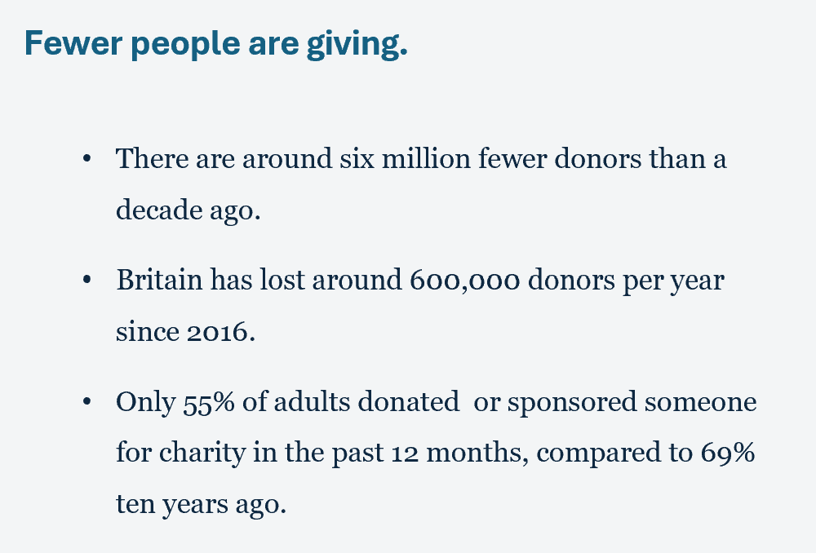
A SHRINKING DONOR BASE

Slide 6
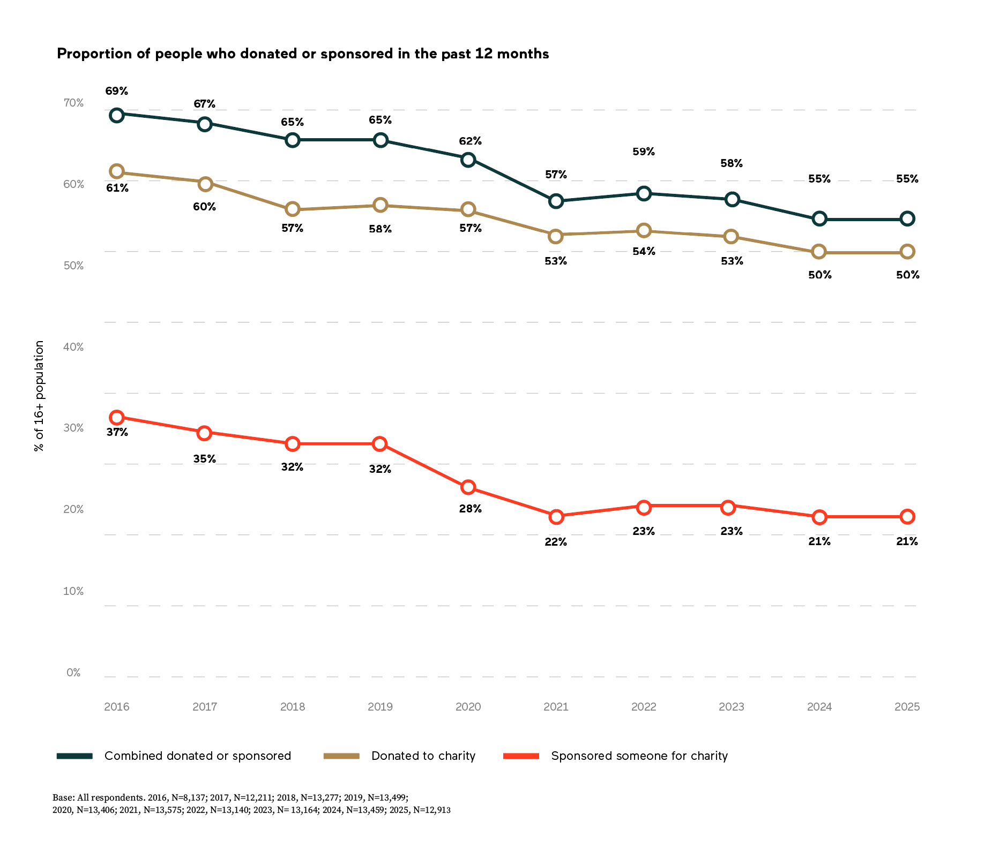

Slide 7
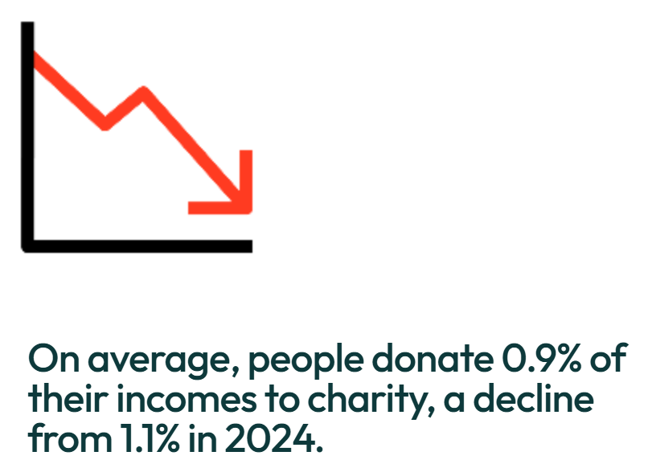

Slide 8
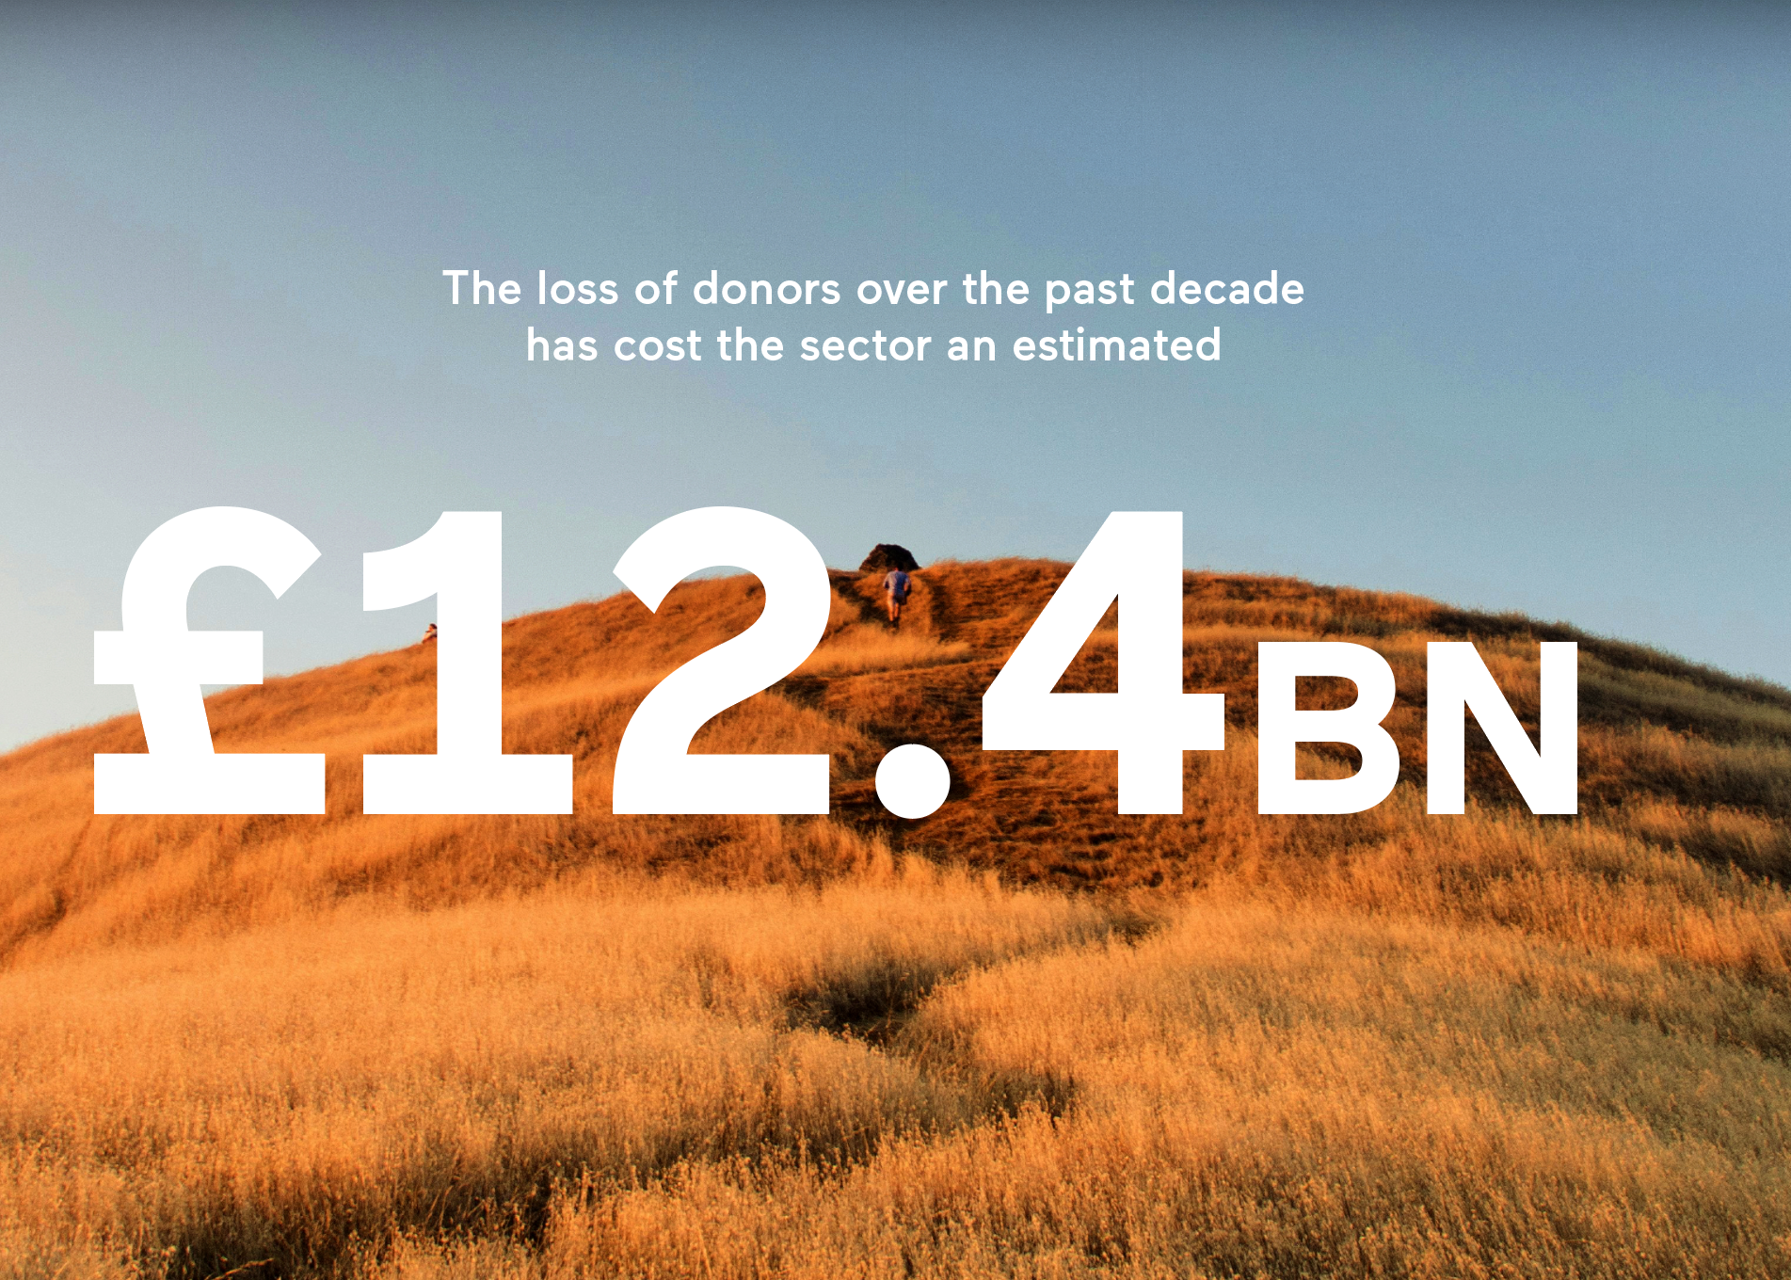
THE FINANCIAL IMPACT

Slide 9
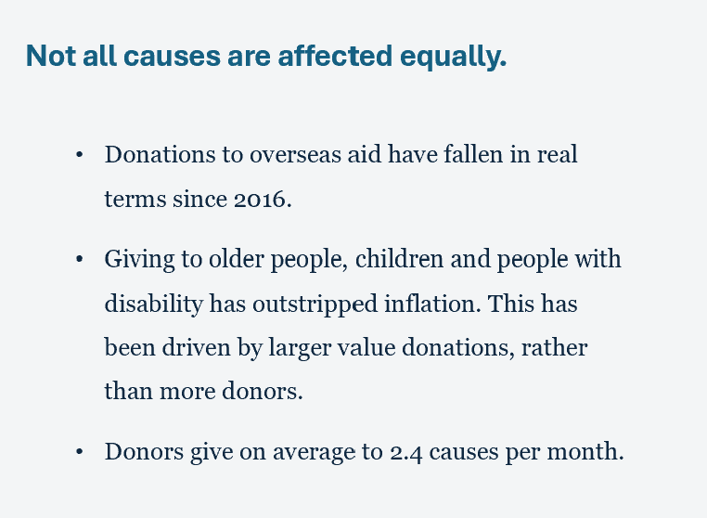
CAUSE-LEVEL SHIFTS

Slide 10
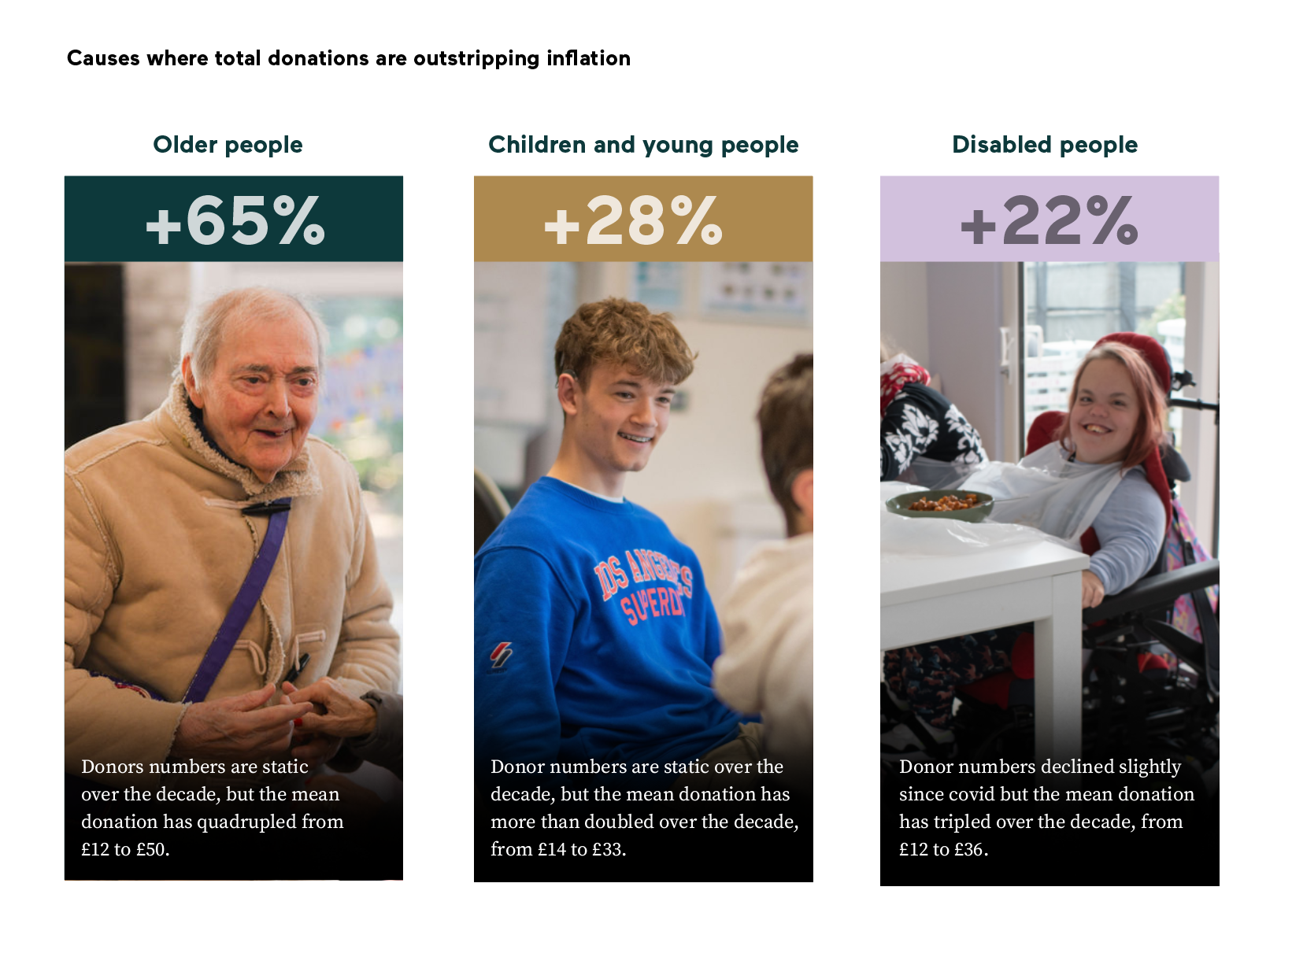

Slide 11
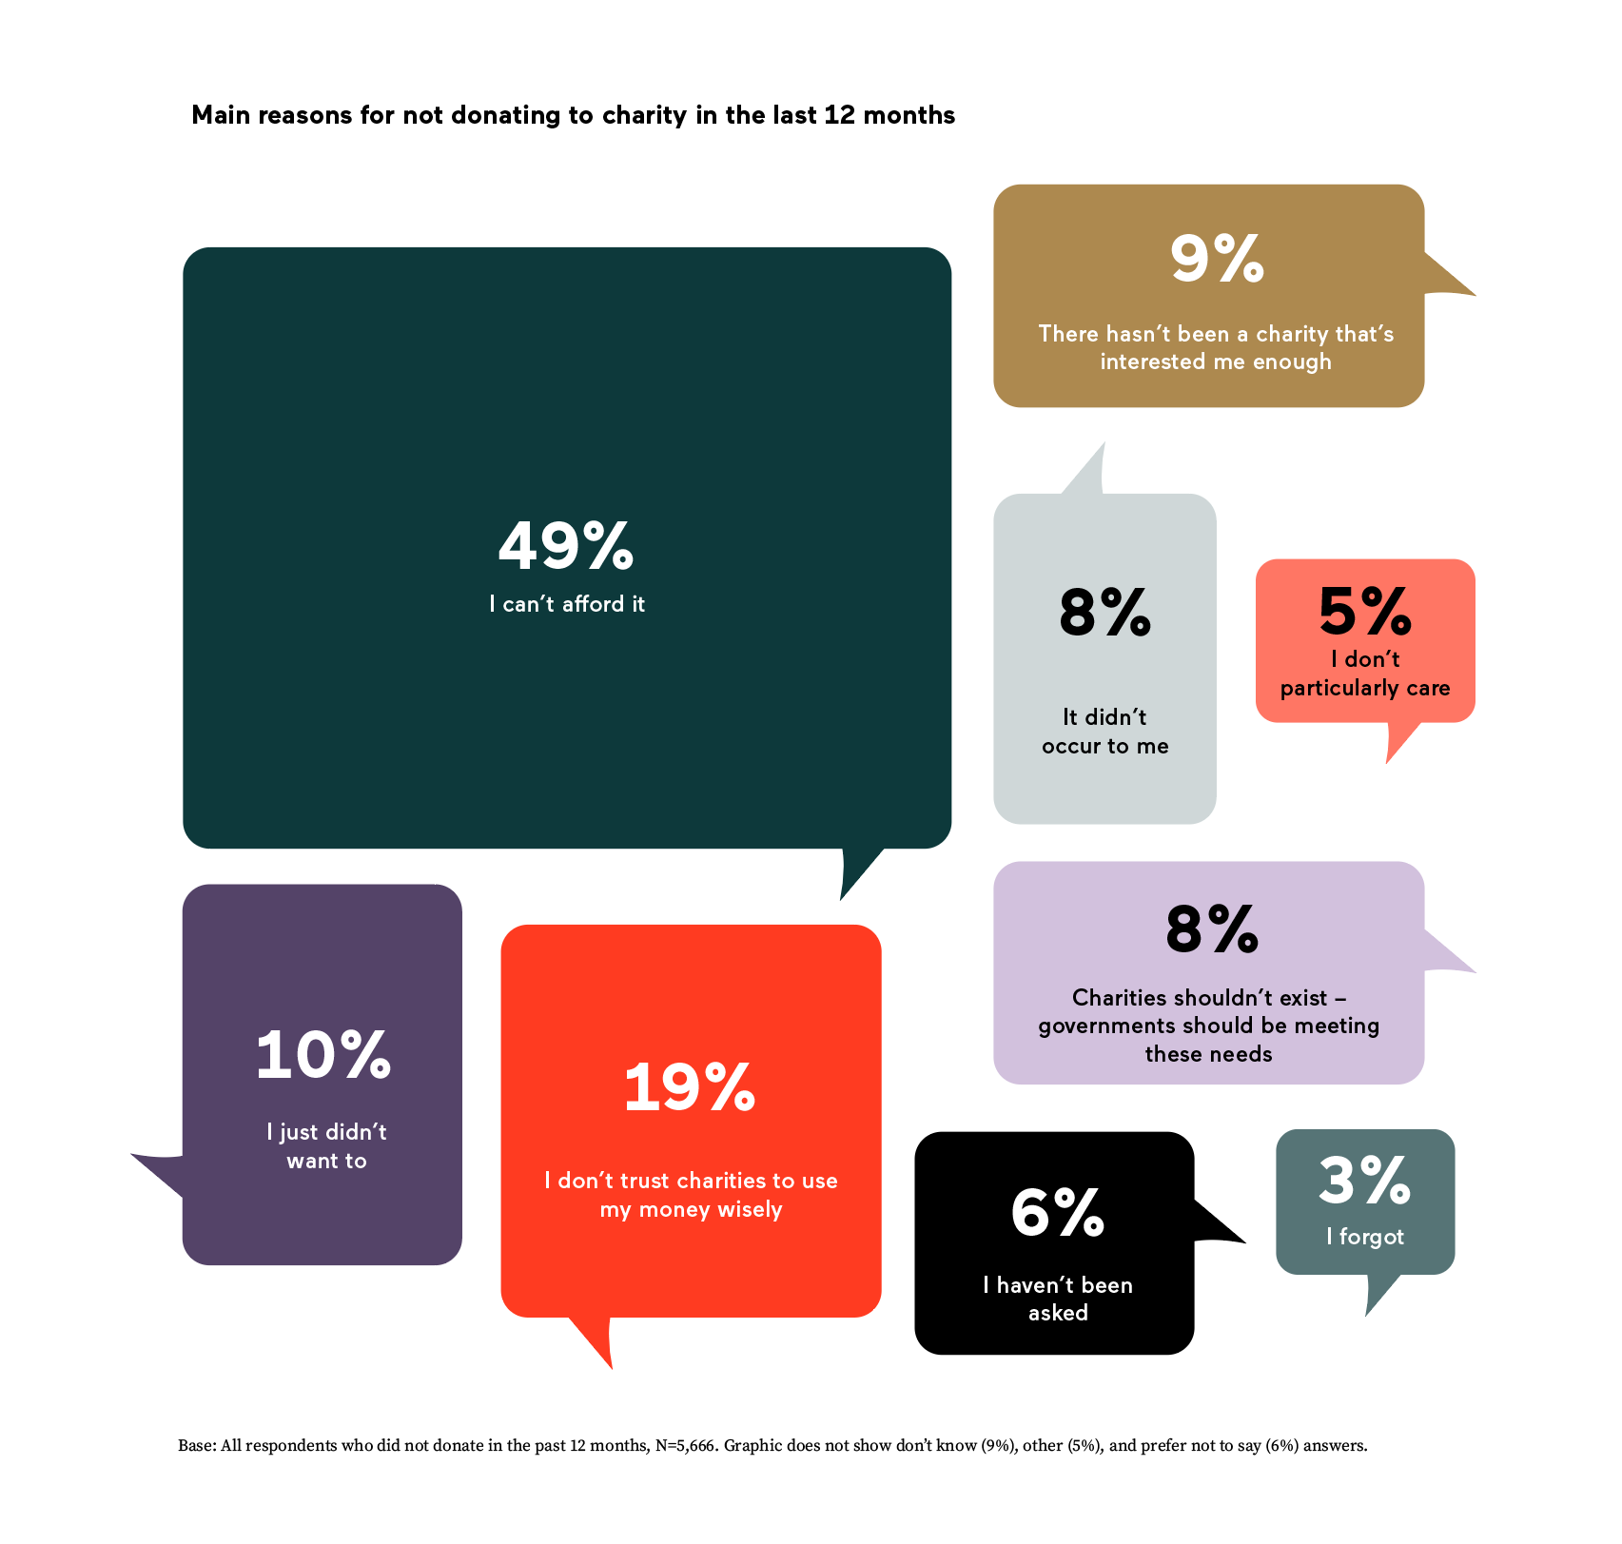
WHY PEOPLE DECIDE NOT TO GIVE

Slide 12
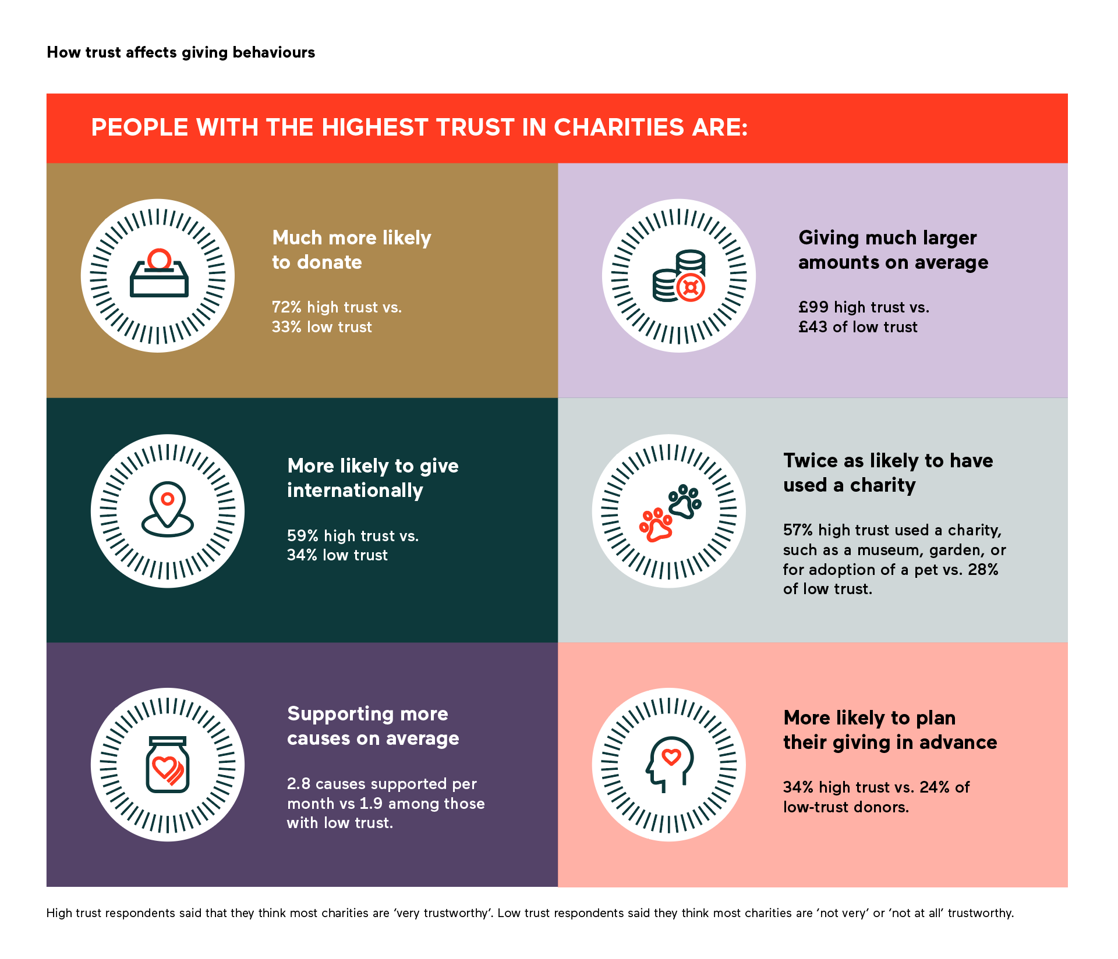
TRUST DRIVES INCOME

Slide 13
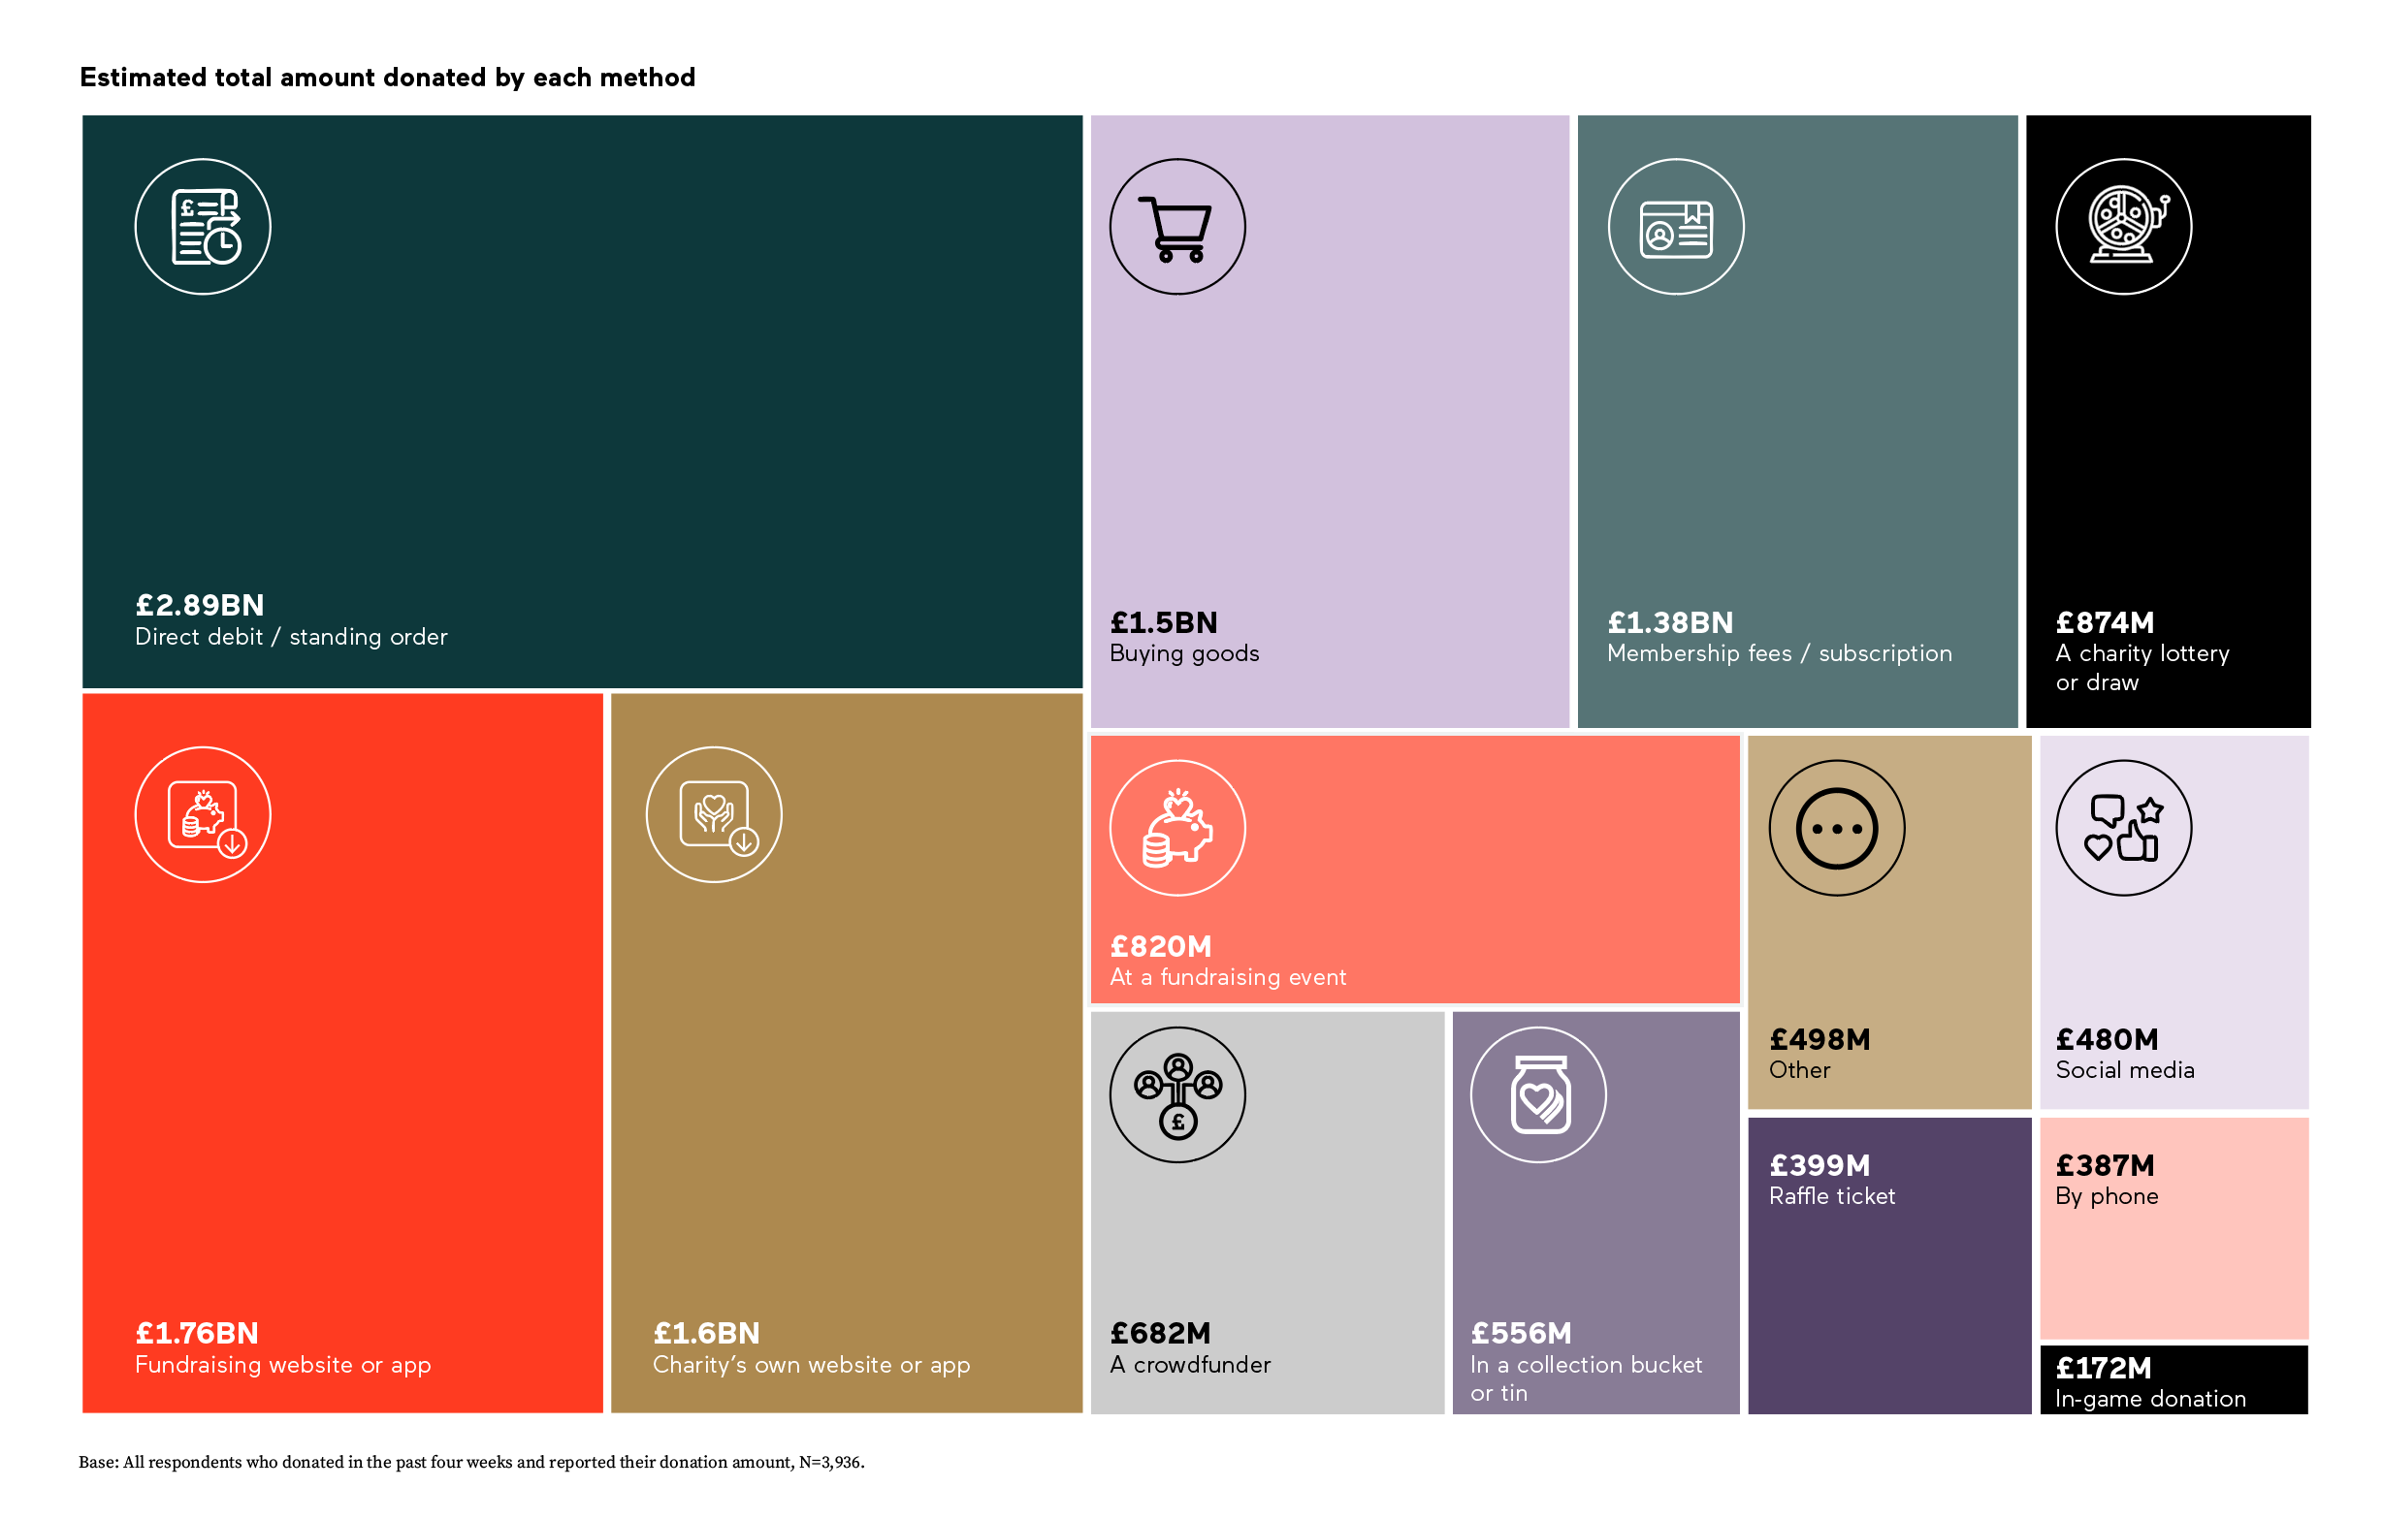
GIVING IS UNPREDICTABLE

Slide 14
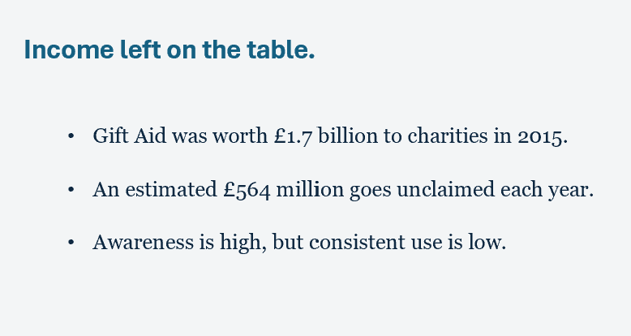
GIFT AID

Slide 15
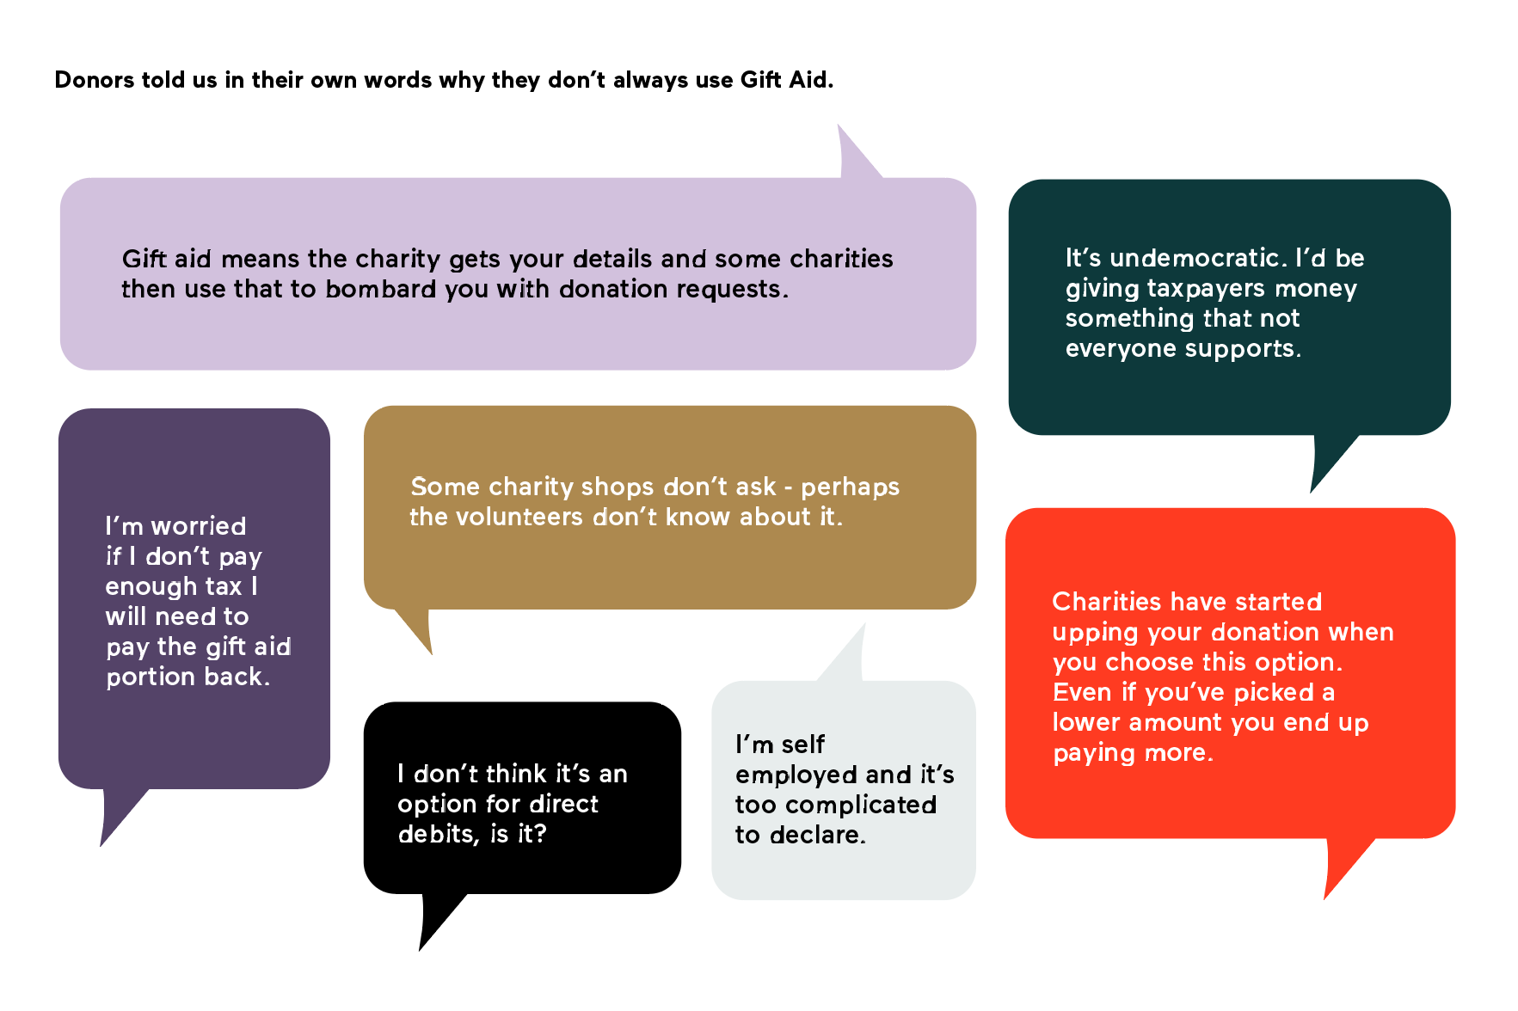

Slide 16
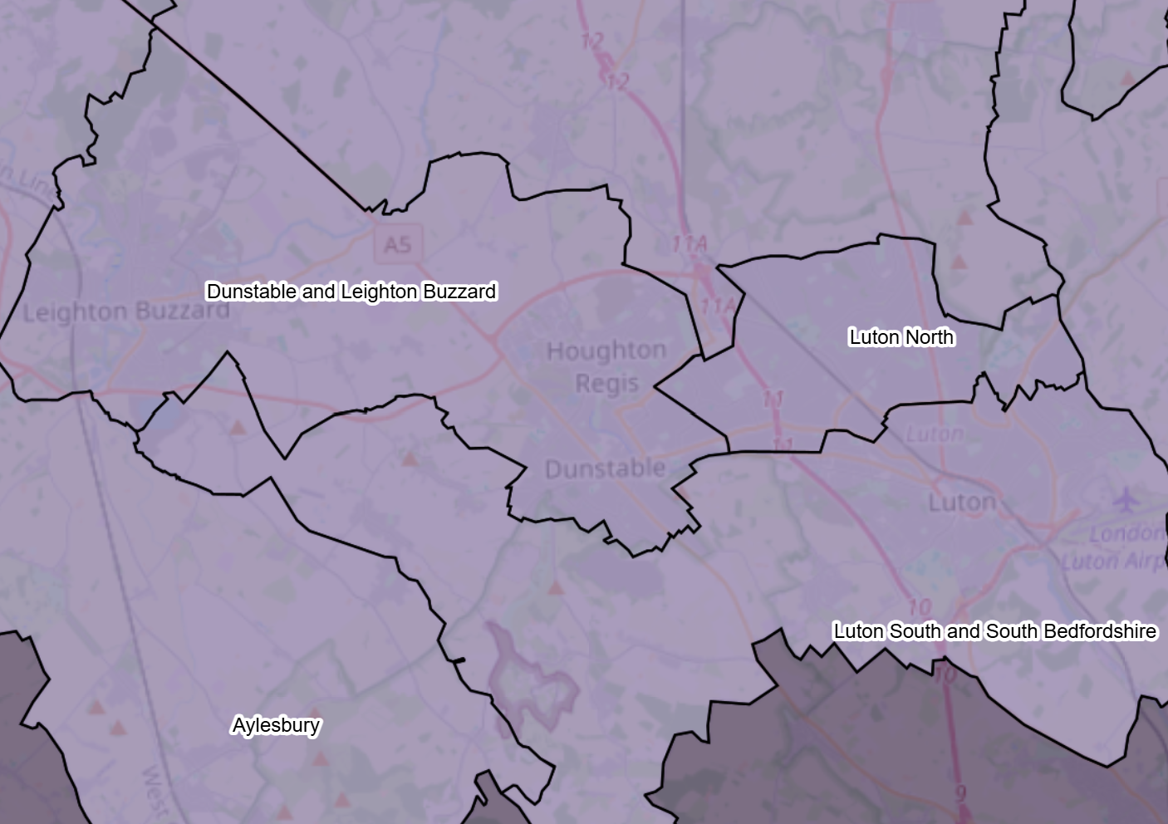
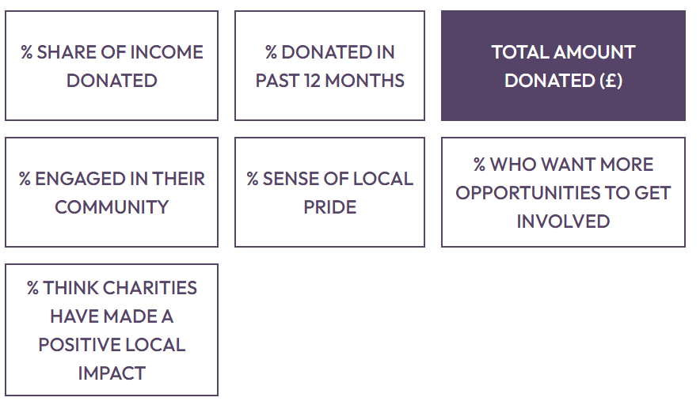

Slide 17
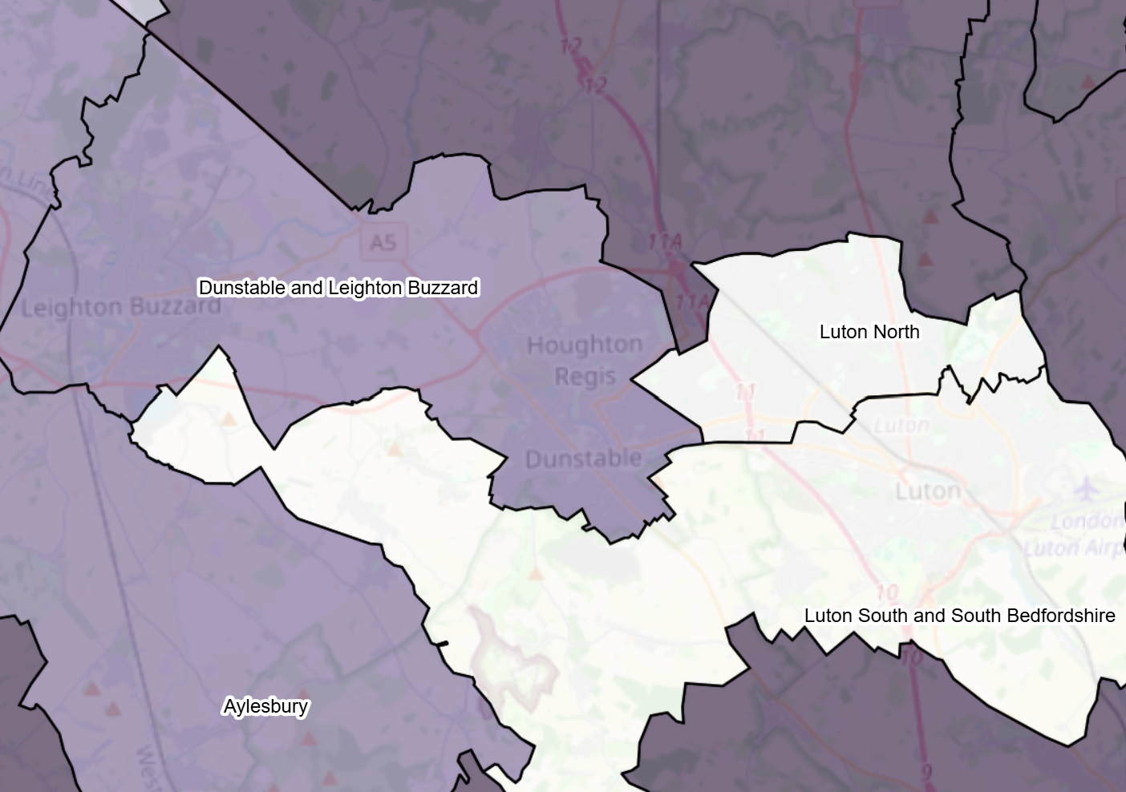
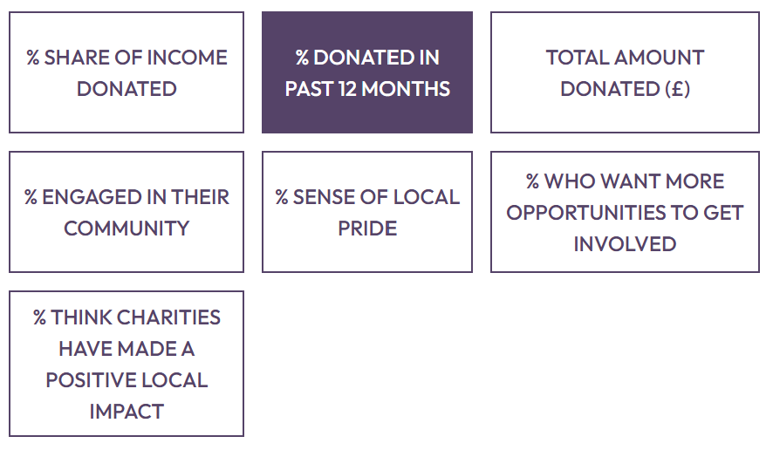

Slide 18
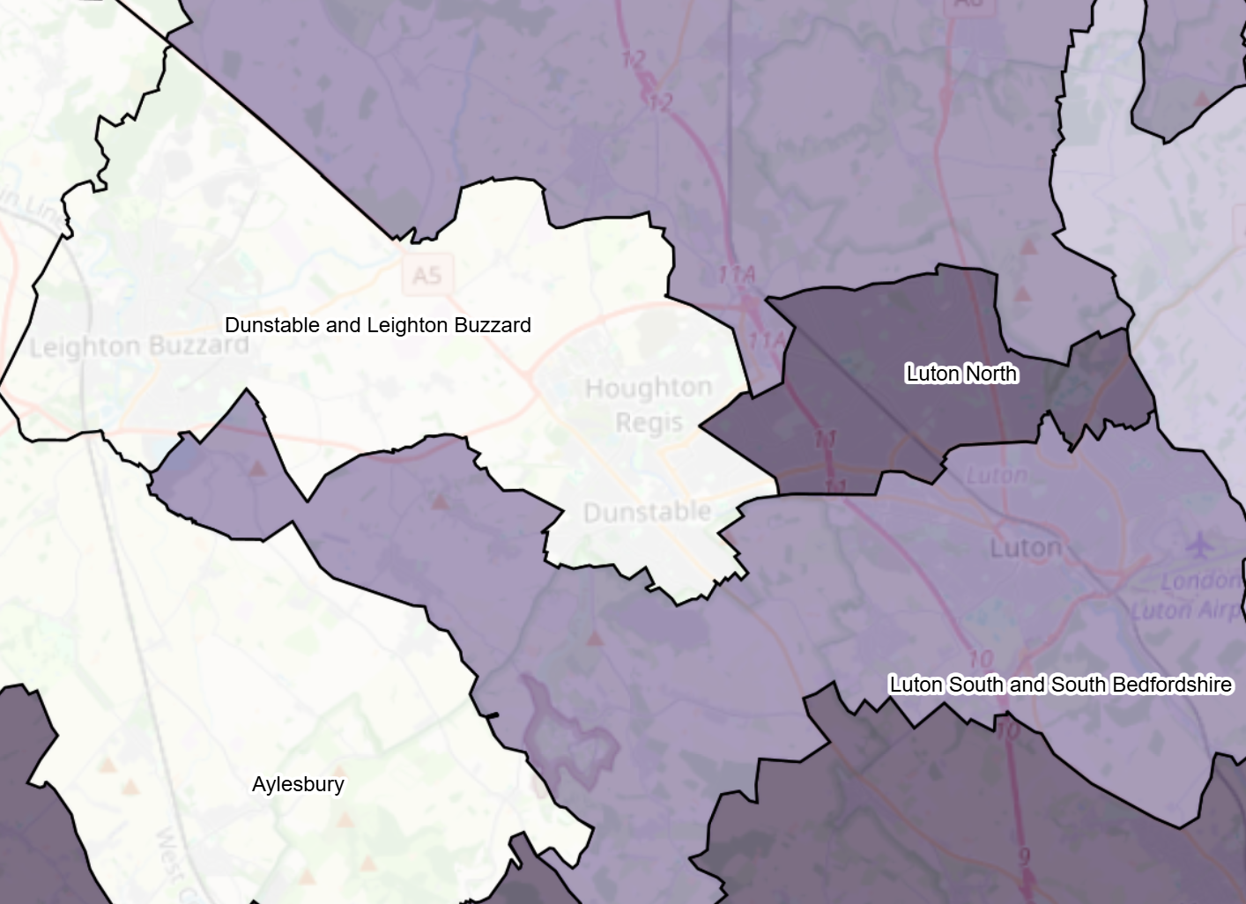
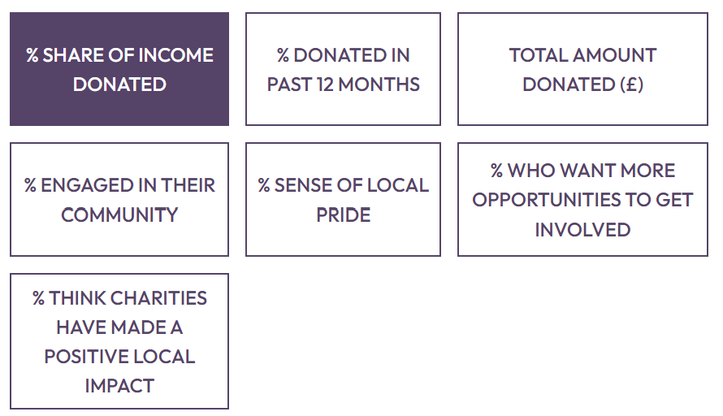

Slide 19
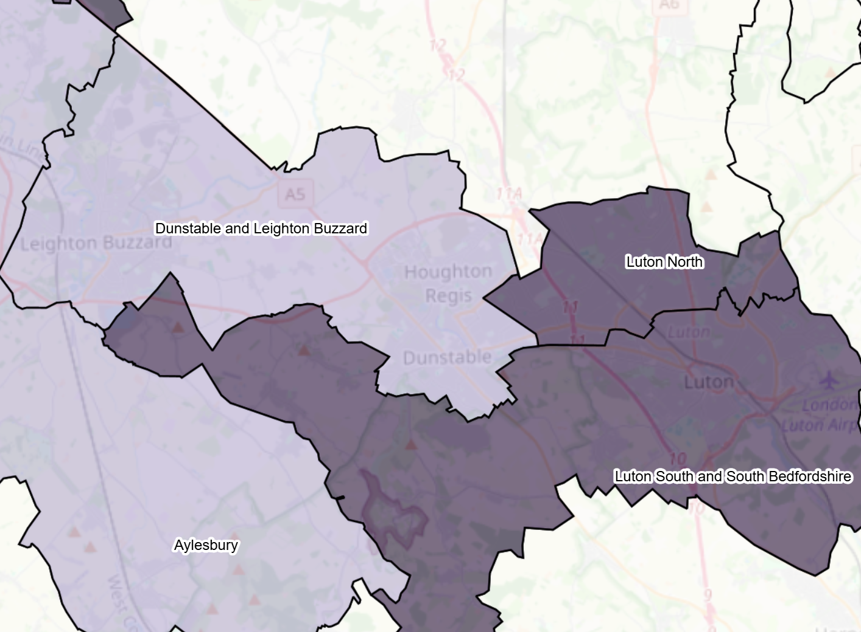
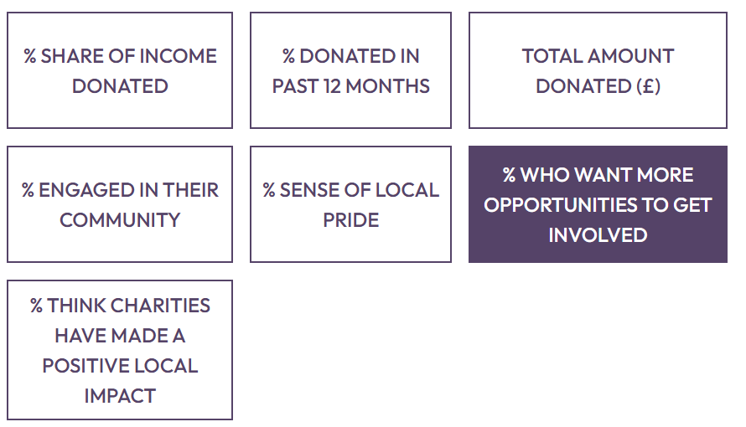

Slide 20
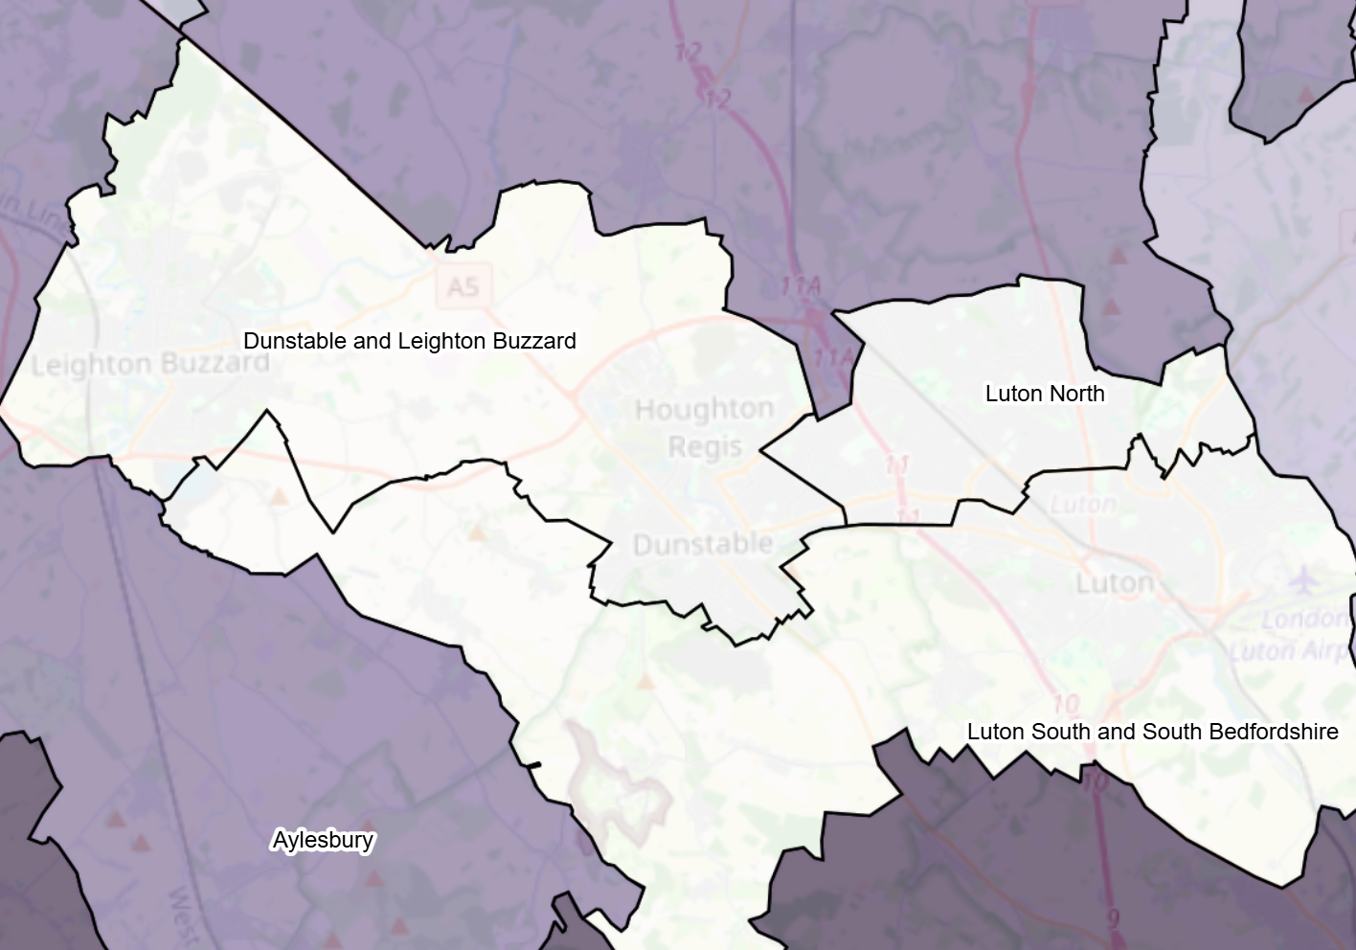
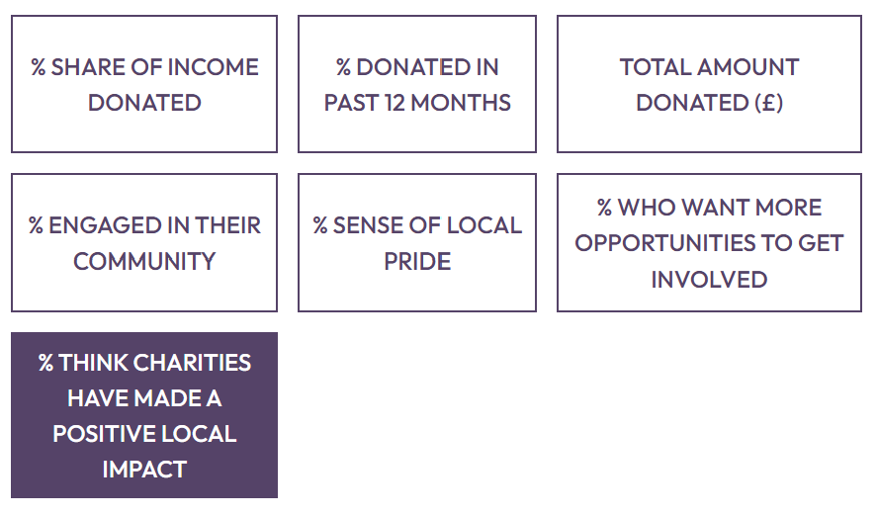

Slide 21
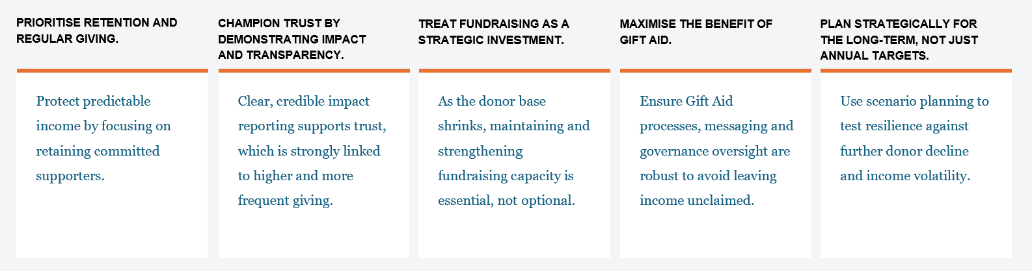
WHAT DOES THIS MEAN FOR TRUSTEES?

Slide 22

clientrelations@cafonline.org

